Slide 1
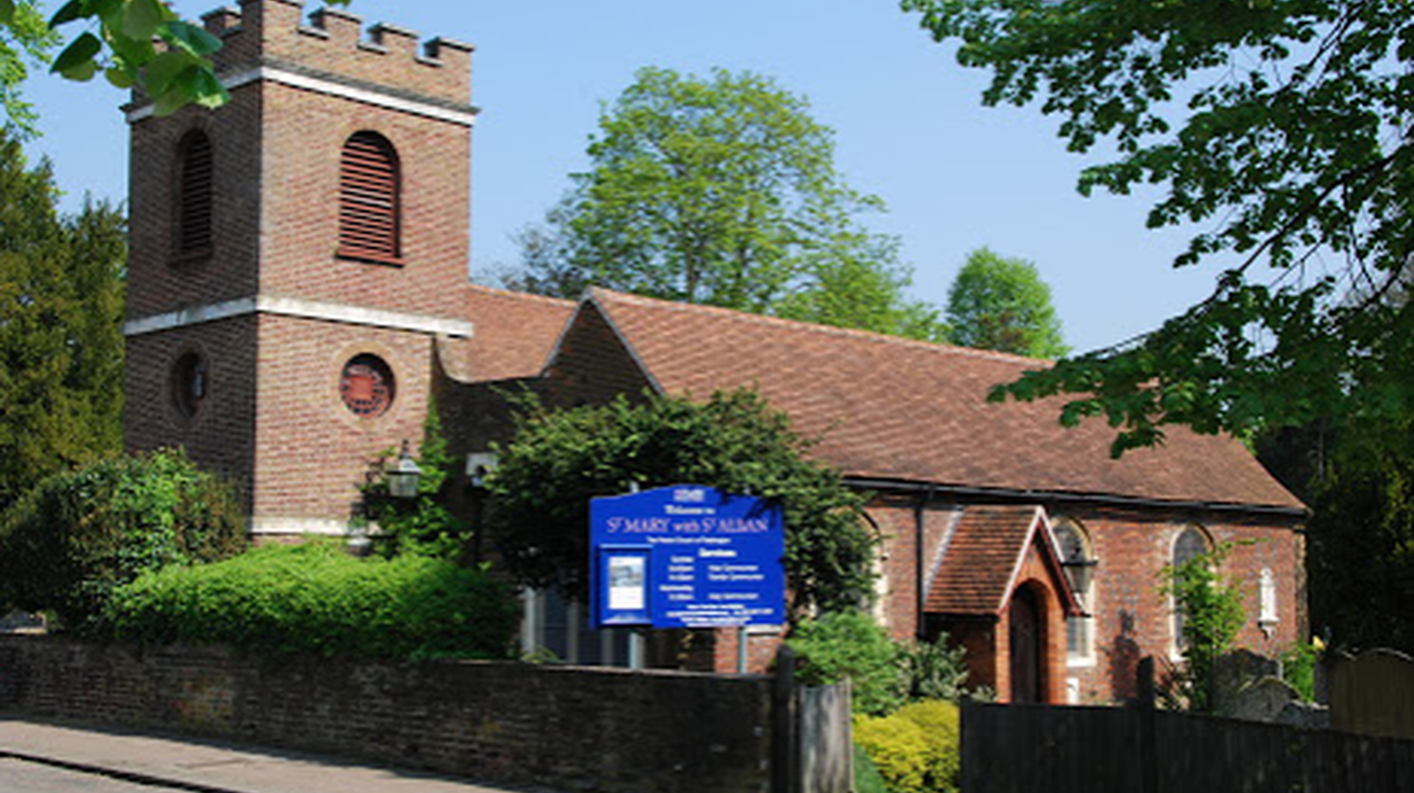
9am at St Mary with St Alban
Teddington

Slide 2
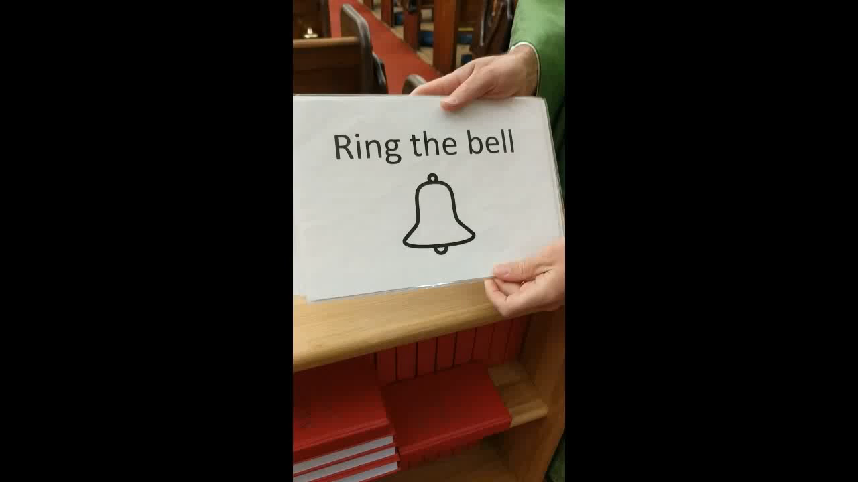
Intergen worship
The rota that isn’t a rota
Notes:
Video

